Slide 1
Introduction to Patent Analytics
Manchester
May 26, 2017
Irene Kitsara
IP Information Officer, Access to Information and Knowledge Division

Slide 2
Evolution of analytics to support decision-making and IP management
Consultation of individual scientific literature
Patent Information Search and manual results analysis
Patent/IP Analytics
Tradition/
Intuition/
Interests/
Rumors
Data analysis
Big data analysis
Smart data analysis
Statistics

Slide 3
How are decisions taken and how does patent information help?
Cross sectoral/disciplinary effort: many aspects taken into account (Science/Policy/Economics/Business/Marketing)
Policy/prioritization issues
Relevant market definition and analysis
Competitors activity and analysis
Economic/financial aspect
Risk
Patent Information: important source of information
Technical
Business data
Legal

Slide 4
What is the added value of patent analysis?
Presents patent data, search results and findings in a structured way
Creates an output that makes technical data easily understood by non-experts
Includes visualization of the results making the information easily and fast to digest
Facilitates interdisciplinary dialogue between various stakeholders

Slide 5
Different types of patent analysis and similar products
Patent Landscape Reports
Freedom to Operate Analysis
Portfolio analysis
Business/Competitive intelligence report
Technology Watch/Alerts
Technology Bulletins
General Statistics

Slide 6
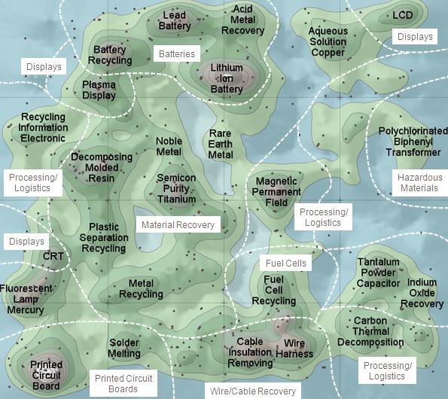
What is a Patent Landscape?
Fuzzy term, often expressed in different ways, e.g.:
Patent Map, Patent Cartography
Business Intelligence, Competitive Intelligence
Various definition approaches:
from very narrow
(just a graphical representation)
to very broad
(Freedom to Operate analysis)
« Patent map »
Source: WIPO PLR on Electronic Waste Recycling

Slide 7
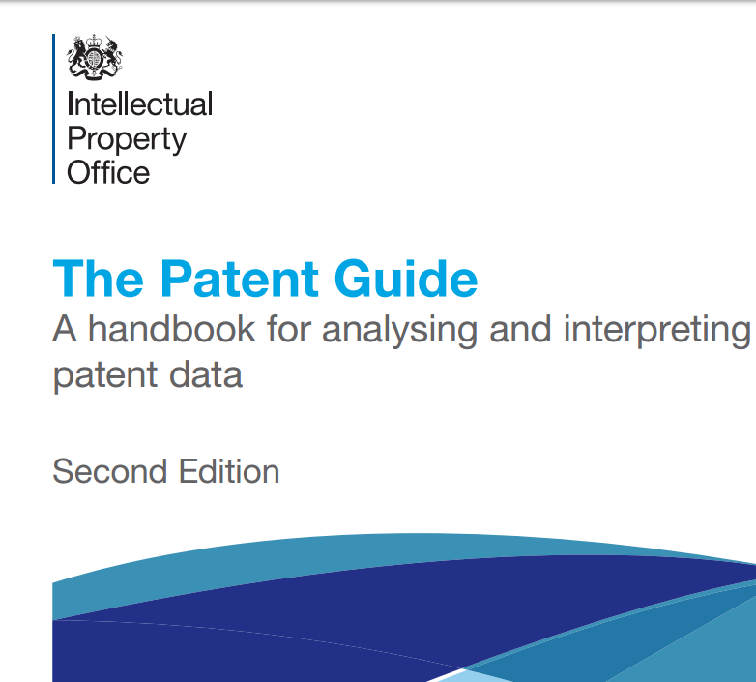
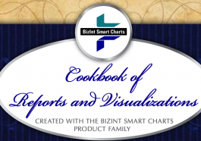

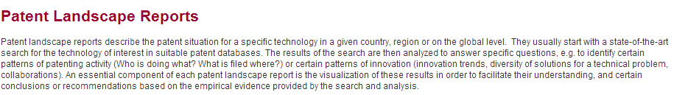


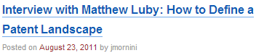
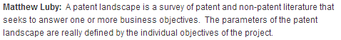


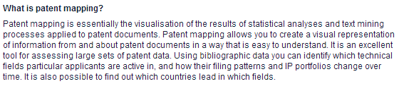
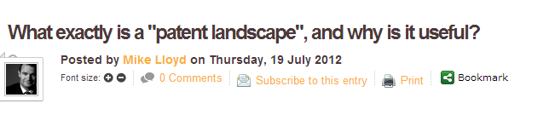
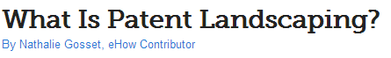
PLR Terminology and Methodology

Slide 8
What is a Patent Landscape Report (PLR)?
Research and analysis of patenting trends in a specific technological field/geographical area using patent data
Content and analysis types customized to the concrete needs
It can have a very narrow to a very broad scope and serve various needs, e.g. WIPO PLR on atazanavir and the PLR on animal genetic resources
Geographical coverage can vary and can have or include country focus (e.g. BRIC countries)
It typically does not include legal status information, yet in some cases such data forms part of the report
Raw Data
Patent Search
Patent Analysis

Slide 9

What kind of questions can a PLR answer?
(The Answer to The Ultimate Question of Life, the Universe, and Everything, The Hitchhiker's Guide to the Galaxy, Douglas Adams)
Which technology trends exist in which geographical areas and how have they developed over time?
Are there gaps or white spaces, i.e. areas with little patent protection, that permit business opportunities or give them an added value?
Which players are the most active in a said technical area and what is their specific focus and strategy?
Which other patents are relevant for a company’s activities or a product development/commercialization? (Infringement/FTO, licensing-in, collaborations)
Which patents are about to expire ? Which technologies move in the public domain and provide business opportunities ?
What is the patent portfolio of competitors and what is the impact on the company’s portfolio and activities? Correlation and effect on value

Slide 10
Profile of Patent Landscape Reports users
Industry: standard procedure included in decision making mechanism (patent portfolio management, R&D investment and prioritization, technology transfer etc)
Public sector:
Providers: National Patent Offices/research institutes preparing reports in areas of general interest/specific need or providing landscaping services to the public
Users: awareness raising phase – more and more public institutions seeking ways to facilitate their policy discussions and similar to the private sector decisions

Slide 11
What a typical PLR user is looking for
Confirming he is not re-inventing the wheel
Identifying areas of interest for R&D or investment
To patent or not to patent? Keep/abandon IPR?
Monitoring the activity of his competitors
Identifying cooperation partners
Identify potential markets
Evaluate his own portfolio or a third party’s patent portfolio

Slide 12







Different scenarios in the preparation of a Patent Landscape Report (PLR)
PLR prepared in-house or contracted out? (internal or external clients?)
Purpose of the report (business intelligence / competitor analysis or to serve public interest?)
Decision involved
Profile of client/team involved
Professor
Manager
Market Analyst
Patent Analyst

Slide 13
What kind of analysis can be included in a Patent Landscape Report?

Slide 14
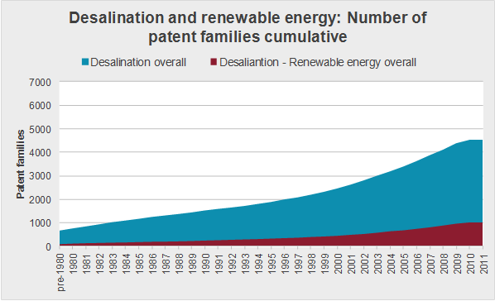
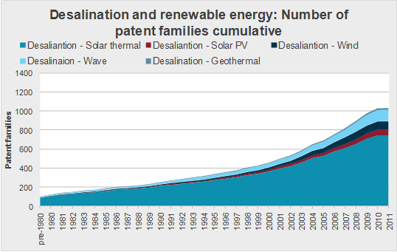
General trends vs. trends in subsectors
Source: WIPO PLR on Water desalination and the use of renewable energies
Help identify promising, emerging or saturated technology areas
Identification of potential niche technologies

Slide 15
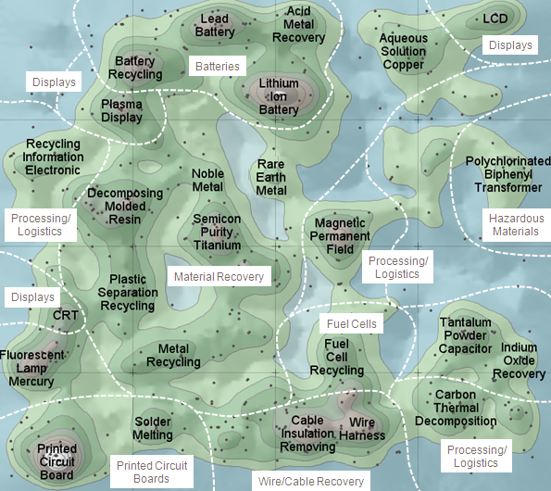
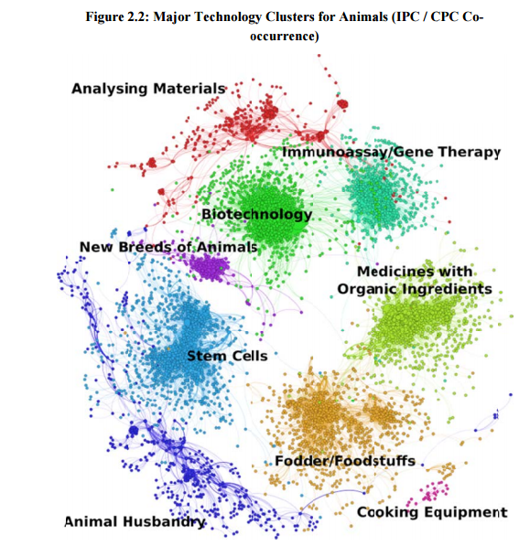
Clustering of prominent technology areas
Network mapping in Animal Genetic Resources PLR
Thematic Concept (Themescape) of E-Waste Landscape

Slide 16
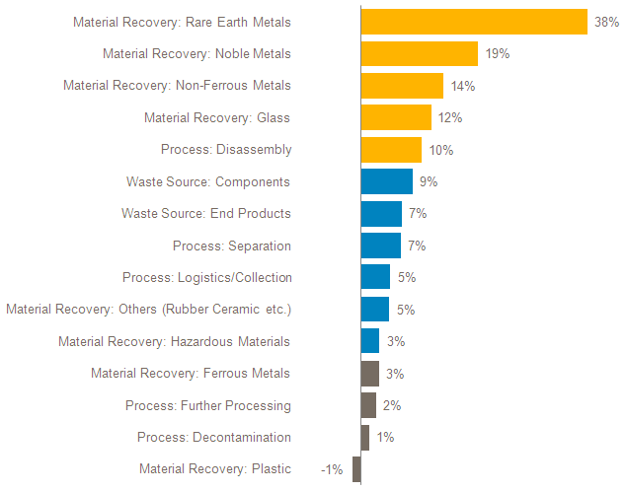
The E-Waste example: Growth rate in patenting reflecting recent/growing market needs/regulatory changes
Rare Earth Metals: 90% primary extraction in CN – not an open commodity
Focus on Rare Earth recovery due to importance for electric consumer goods
Growth in patenting activity related to silver: change of EU solder regulation (replacement of lead by silver and copper)
Patenting Activity Trends in E-waste by Subject Matter; Annual Growth/Decline 2006-2010 (based on Earliest Year of First Filing)

Slide 17
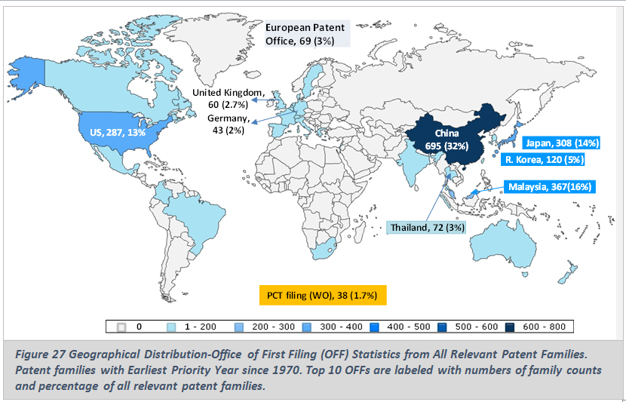
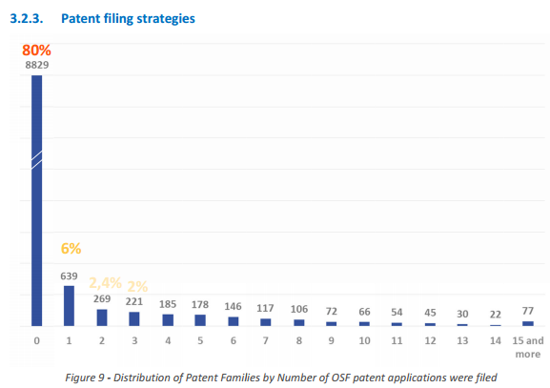
Geographical distribution of patent protection
General trends (OFF)
Patent filing strategies
Source: WIPO PLR on Palm Oil
Source: WIPO PLR on Microalgae

Slide 18
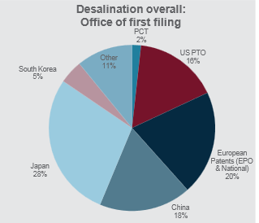
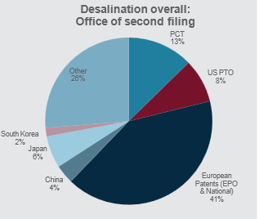


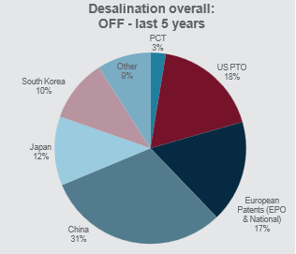
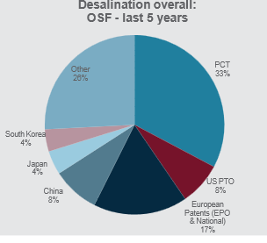

Geographical distribution of patent protection
Office of first filing (OFF) – indicator of innovation
Office of second filing (OSF) – choice of strategic importance
Source: WIPO Desalination PLR

Slide 19
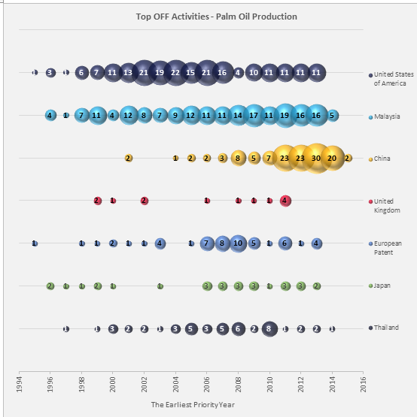
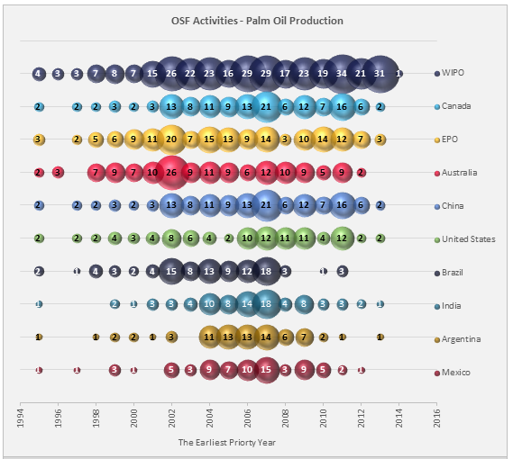
OFF and OSF as indicators of innovation and potential market
Top OFF – Filings over time
Top OSF – Indirect market analysis

Slide 20
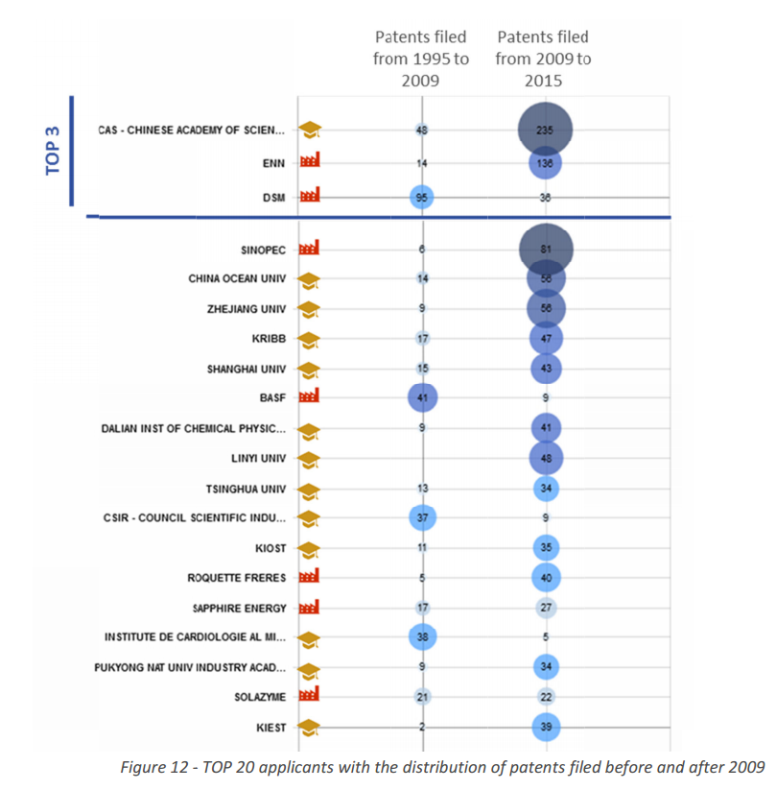
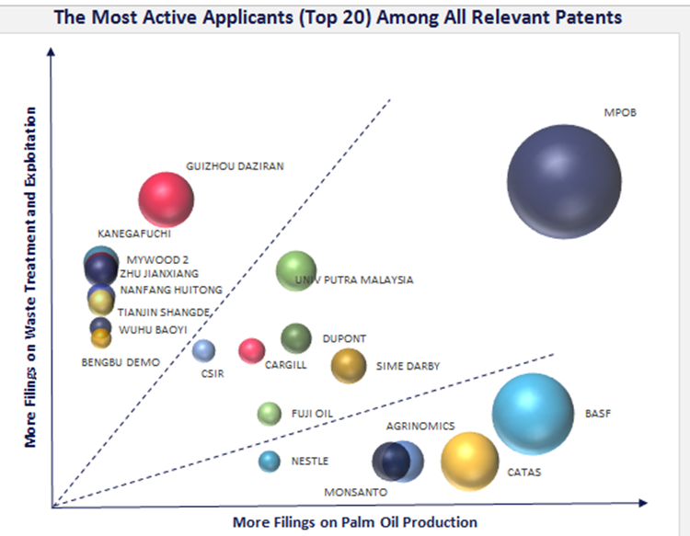
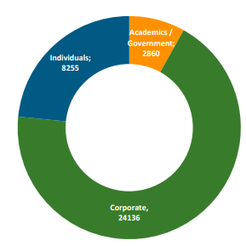
Major players in a field, profile, new players, change in focus and strategy
Key players, profile, recent activity
Key players focus areas
WIPO PLR on Palm Oil
WIPO PLR on Microalgae
WIPO PLR on Assistive Devices for Visually and Hearing Impaired Persons

Slide 21
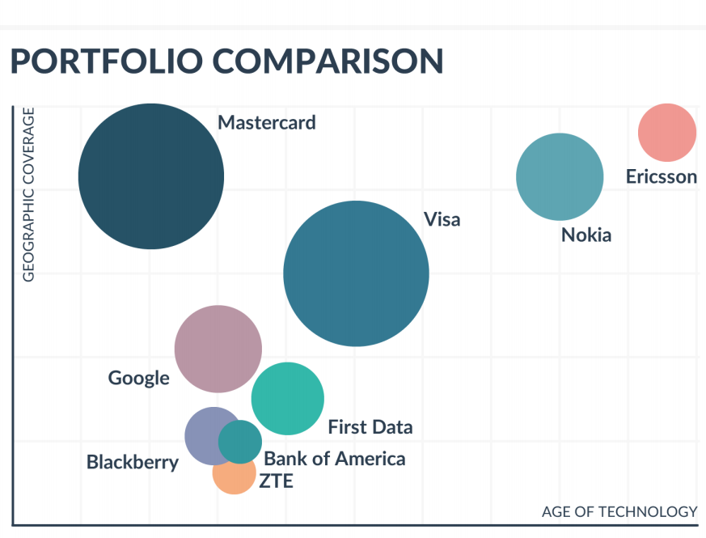
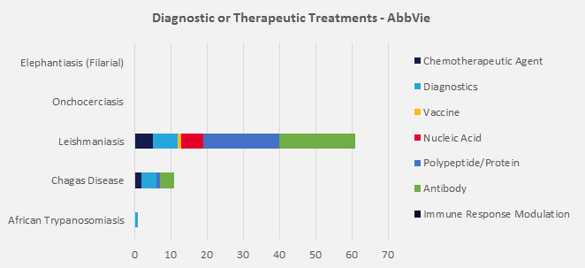
Specific applicants analysis
Applicant focus and portfolio
Geographical coverage and age of technology
WIPO Selected Neglected Diseases PLR

Slide 22
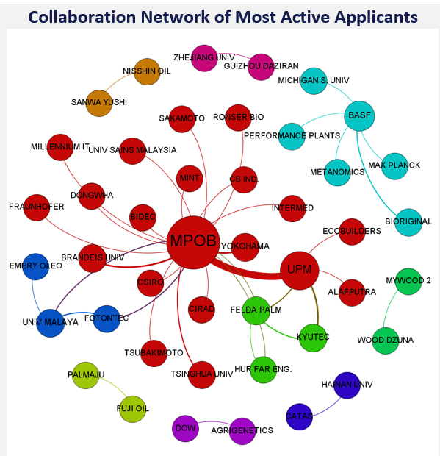
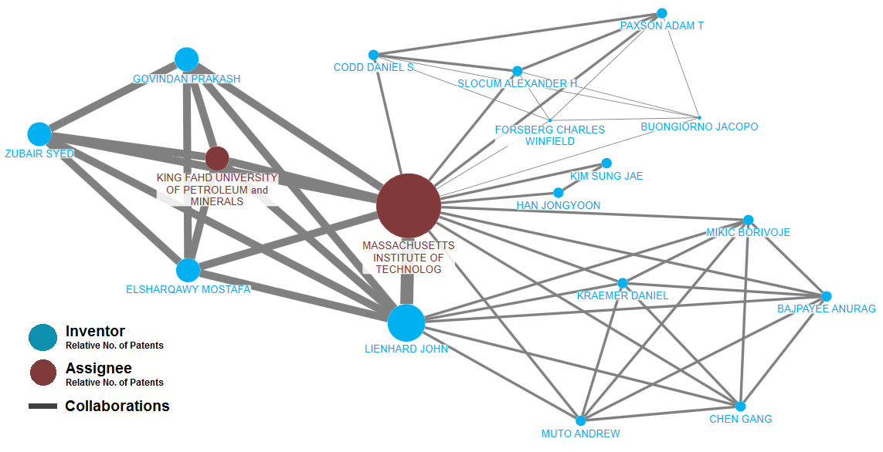
Co-assignments and collaboration networks
Co-assignments – applicants’ collaboration networks
Applicant-inventors collaboration network
WIPO Palm Oil Production PLR
WIPO Desalination PLR

Slide 23

Matching patents to products
Source: WIPO PLR on Solar Cooking

Slide 24
Combining patent with non-patent data
Source: IEA, Energy Technology R&D Statistics 2007
R&D in- and output, patenting activity as indicator of innovation

Slide 25
Patent Landscape Reports in a nutshell
Patent based analysis tailored to specific needs
IP management and internal/external valuation support tool:
more focused approach and informed decisions
avoidance of duplication of work, waste of resources and infringement of 3rd party IP rights
Who is doing what (e.g. top applicants, inventors) where?
Market trends and potential, uniqueness and value of own IP assets and market position, tech transfer possibilities
identification of own potential and position in a given or emerging market and comparison to competitors
facilitation of local and international cooperation and identification of potential for synergies
Additional, non patent-data completing the puzzle, e.g. econometric /competitor analysis, case studies, licensing information, M&As etc.

Slide 26
Overview of WIPO Patent Analytics activities
2010-2017
WIPO
Patent Landscape
Reports
2013-2014
Guidelines for
Preparing Patent Landscape Reports
2015-2016
Manual on Free and Open Source Tools for Patent Analytics
2016 - .....
Patent Analysis trainings in the TISCs
2017.....
Provision on patent analysis services by TISCs

Slide 27
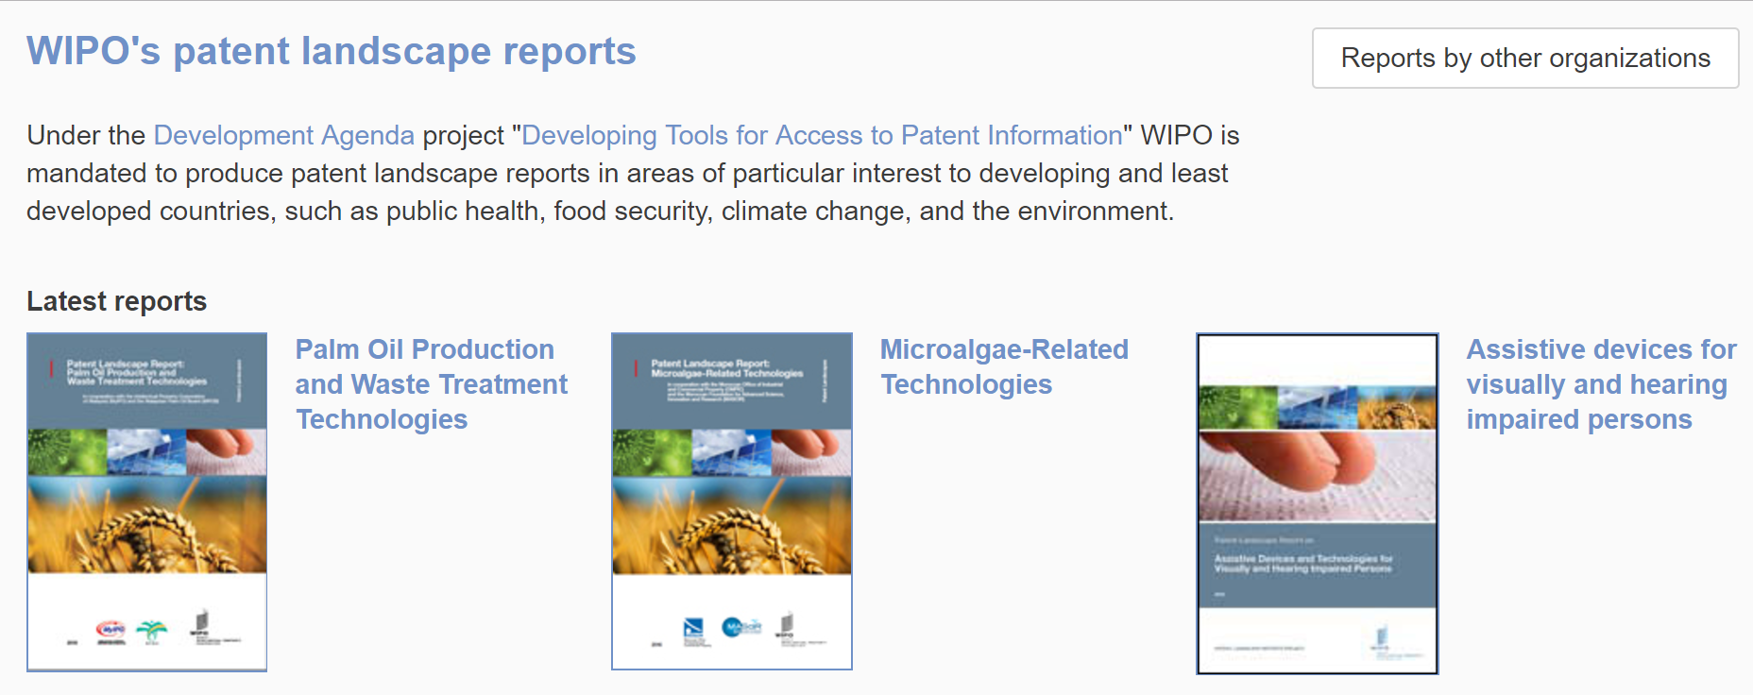
WIPO Patent Landscape Reports
http://www.wipo.int/patentscope/en/programs/patent_landscapes

Slide 28
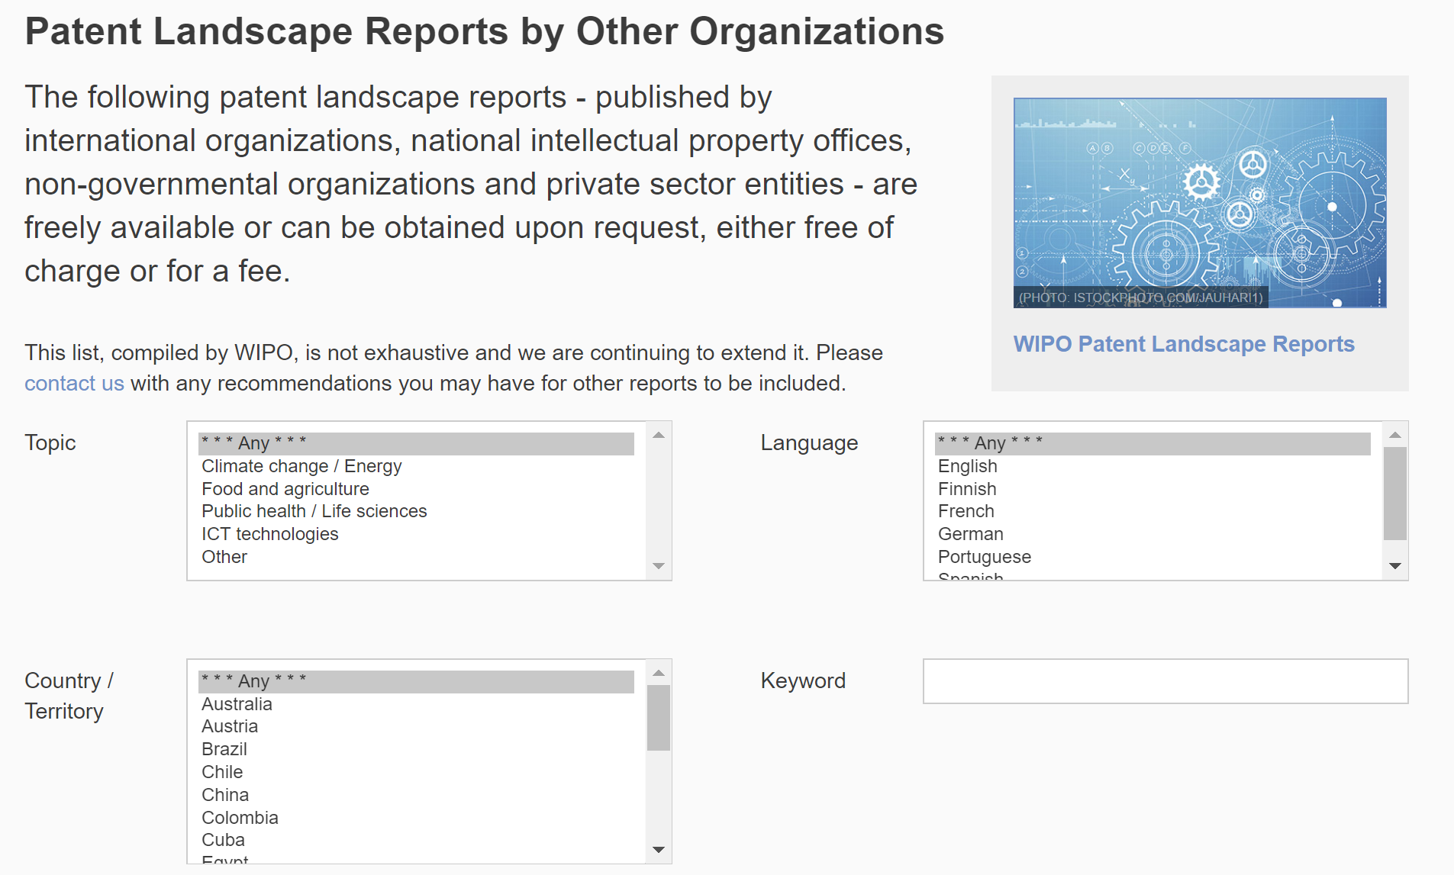
WIPO compilation of PLRs
www.wipo.int/patentscope/en/programs/patent_landscapes/plrdb.html

Slide 29

Guidelines for Preparing PLRs
www.wipo.int/edocs/pubdocs/en/wipo_pub_946.pdf

Slide 30
Other patent analysis types

Slide 31
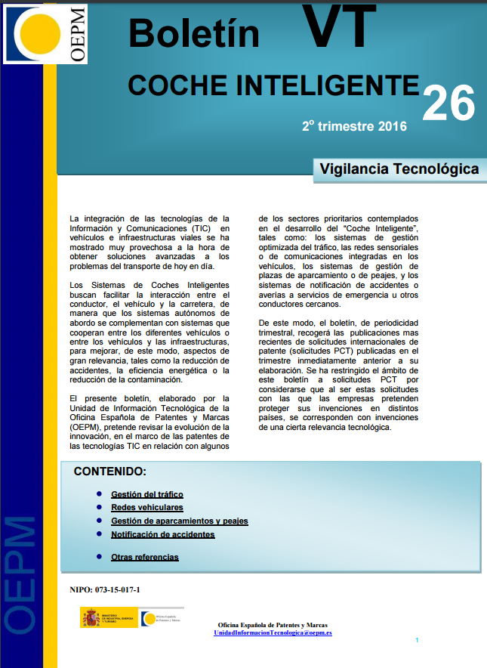
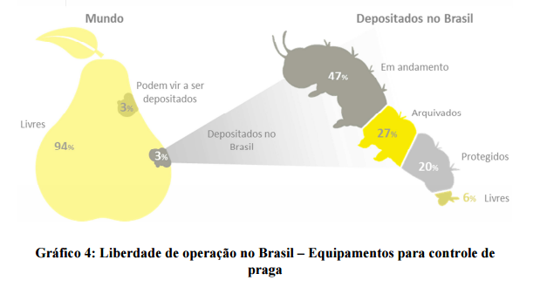
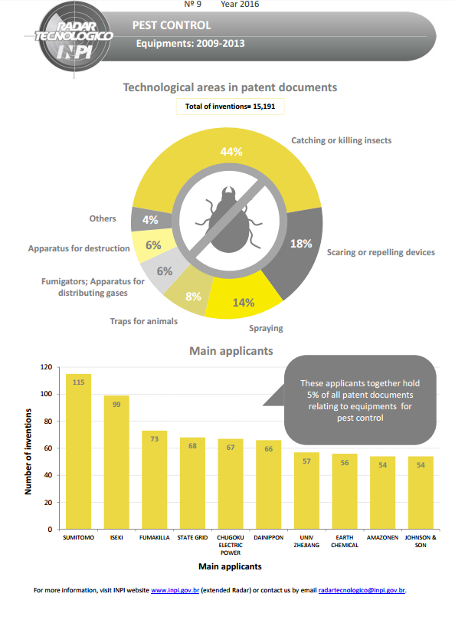
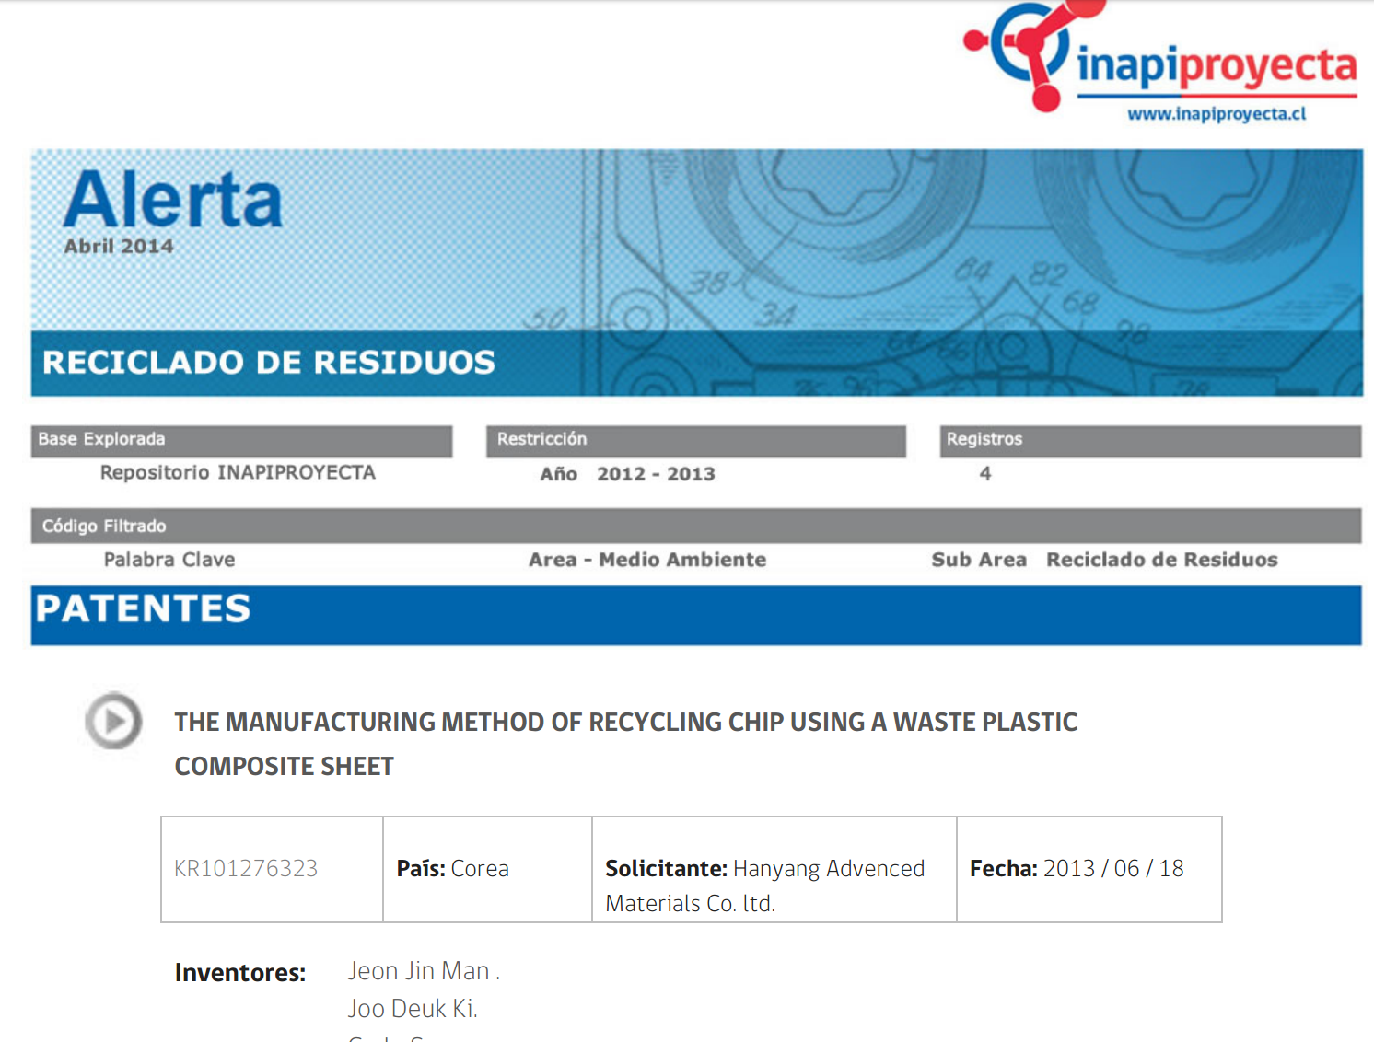
Other Patent Analysis Types
Business/Competitor Intelligence
Freedom to Operate (FTO)
Technology Bulletins/Surveillance/Alerts
Infographics

Slide 32
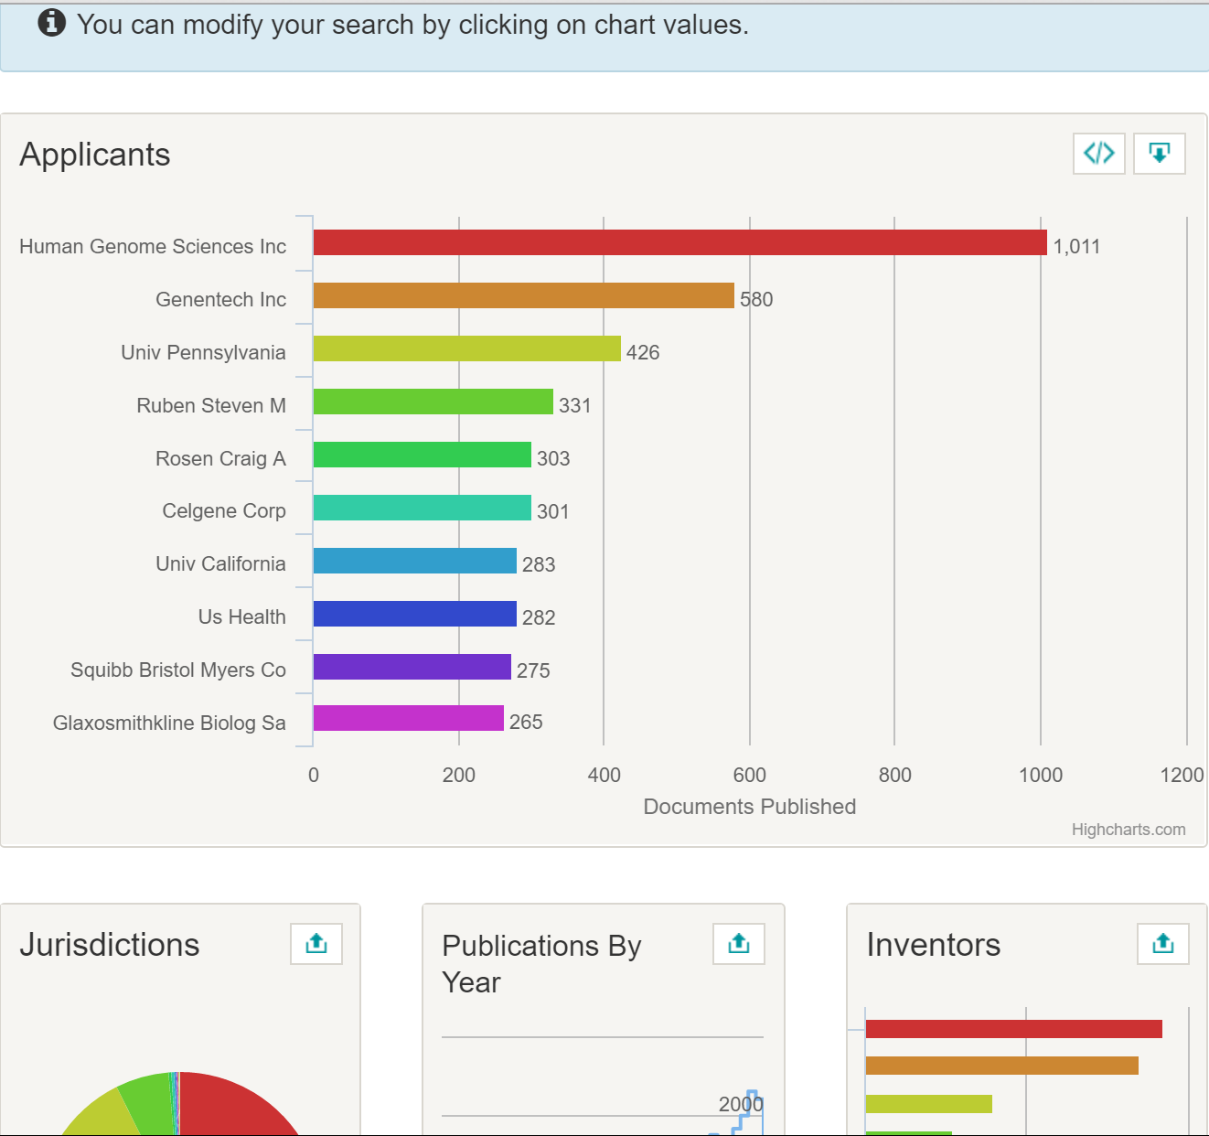
Interactive analytics / Dashboards
The user selects his analysis criteria/filters
e.g. the Lens

Slide 33
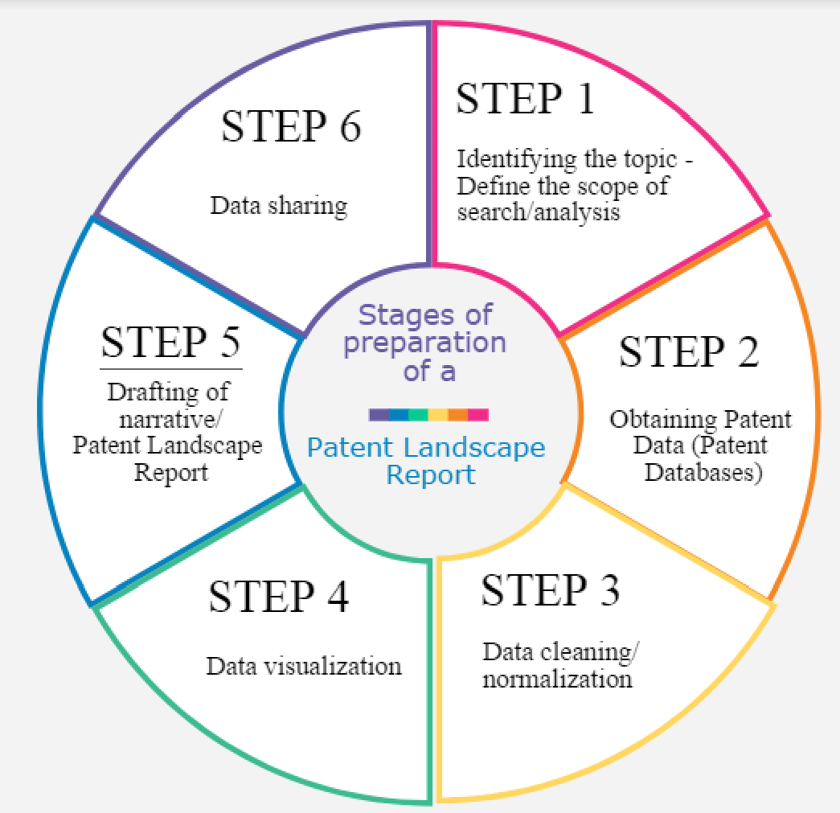
Stages of preparation of a PLR

Slide 34
Planning/Needs assessment
Understanding the client’s business need, decision in question, the information which would be relevant
Brainstorming, discussion, posing a series of questions allowing for the client to better define his needs
Explaining options and limitations of patent landscaping
Timelines and feasibility
Sufficient background information
Ideally: interdisciplinary discussions (joint meetings of management, lawyers, R&D, business analysts, intelligence and patent information team)
Defining the scope of the report, the type of analysis that is useful and appropriate – reiterative process: need for intermediate discussions, redefinition of scope etc.

Slide 35
Challenges in the planning phase
Too abstract understanding of what a PLR is
Difficulties in needs assessment – often Socratic Method used
Lack of clarity about which type of analysis that is needed or exact scope of the search makes drafting the ToR very difficult
Lengthy process of dialogue, exchange of ToR drafts, refinements, changes
The client should be aware of the limitations of the patent information
Requests may just need a state of the art search or be too generic – need for awareness raising often about what landsacaping can offer and then cases when it is appropriate
Distinguishing general interest for the IP perspective from a specific need where patent analysis can feed in

Slide 36
Patent (and non-patent) search
Selection of databases, search methodology crucial for the quality of the data:
Required geographical and historical coverage
Languages and MT tools
Appropriate patent search strategy based on
scope of the report (precision&recall)
use of the report
subject matter in question
preliminary search

Slide 37
Data cleaning/normalization
The challenge of messy data – varies based on system where it is exported from and format
Name variations and misspellings
Cleaning of office of second file data
Numbers normalization
Need of name (applicants/inventors) normalization and grouping (by affiliation, M&A information etc)
Definition of needs and choice of tools
If the dataset comes from different sources, follow the same approach throughout the table/data
Based on system/tool used: manual or semi-automatic

Slide 38
Analysis and visualization of the clean data
Tools, visualization and analysis types to be chosen
Dimensions to be reflected on a visualization (2 or 3 or more)
Clustering of technology areas, components, applications, applicant/inventor profile, geographical areas
Expression of results over time, geographies
Combination of patent with non-patent data
Consultation with the client throughout this and the writing phase essential to confirm that it serves their needs – preliminary results and analysis can trigger need for refinement of search or additional analysis

Slide 39
Preparation of the report and Communication of the results
Report style, language, length etc. should be adapted to the target audience
Big challenge: address the results to multiple profiles (lawyers, managers, scientists). A dedicated area of the report serving each and every one’s need most appropriate
The report should be easy to read, the messages and results clear and the visualizations intuitive and meaningful
An accompanying Infographic, a story-telling approach (e.g. Tableau), a dashboard may be more appropriate based on specific objective of the report
The report should be time-saving for the client and useful

Slide 40
What type of tools are used in patent analytics?
To help in various stages and tasks involved in patent analytics:
(Searching)
Obtaining
Cleaning/Normalizing
Grouping/Clustering Data
Analyzing
Visualizing
Sharing

Slide 41
Matching the tasks with the tools
Tasks and Tool types
Notes
General Tools
Search tools
Cleaning
Text/data mining
Data Visualization
Geographic Mapping
Network visualizations
Infographics
One tool suits all?
Some tools address multiple tasks
Each tool based on different language/approach
Each user should follow the «trial and error» approach

Slide 42



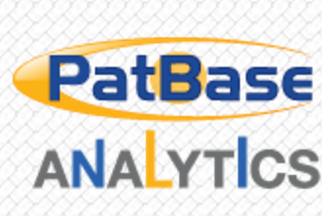




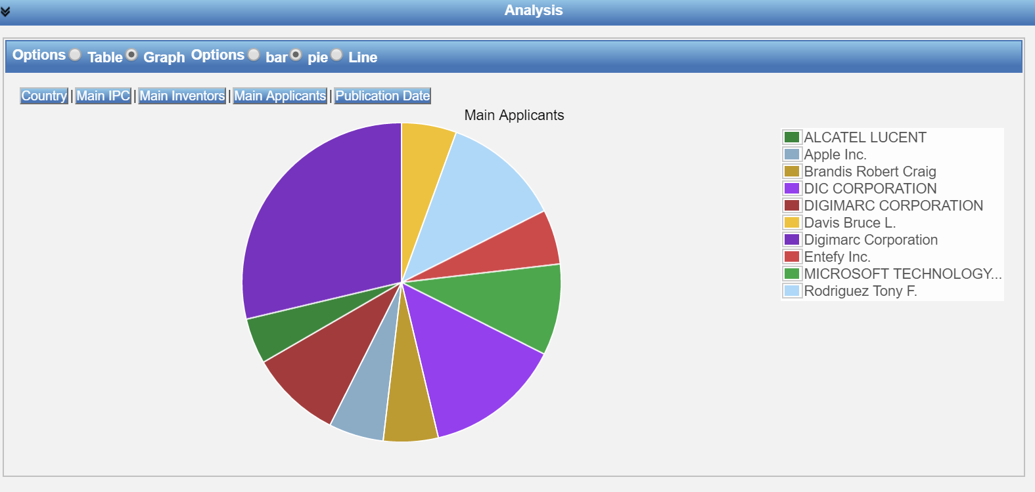

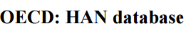

Tools used in Patent Analytics
Commercial:
Embedded in patent databases
Complementary to patent search tools and compatible
Typically dedicated to patent data, with some exceptions
Free of charge:
Some possibilities
Open Source Tools: recent trend

Slide 43
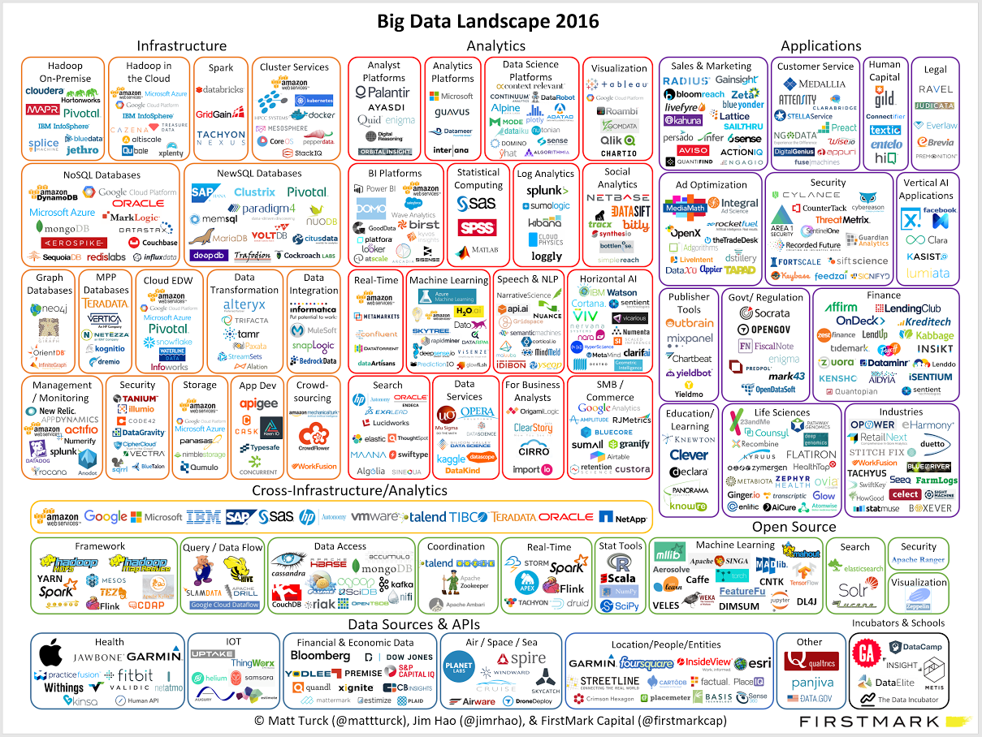
(…some of the) tools facilitating data analysis

Slide 44
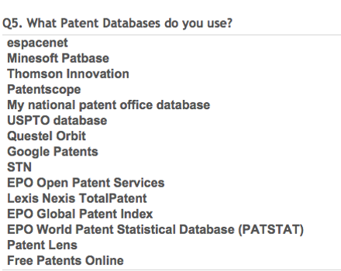
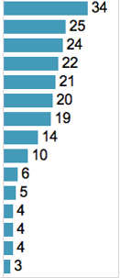
Survey results: Databases used for obtaining data for analytics
Mixture of free and commercial databases
Free databases: espacenet, followed by PATENTSCOPE
Commercial: Patbase, Thomson Innovation, Questel Orbit

Slide 45
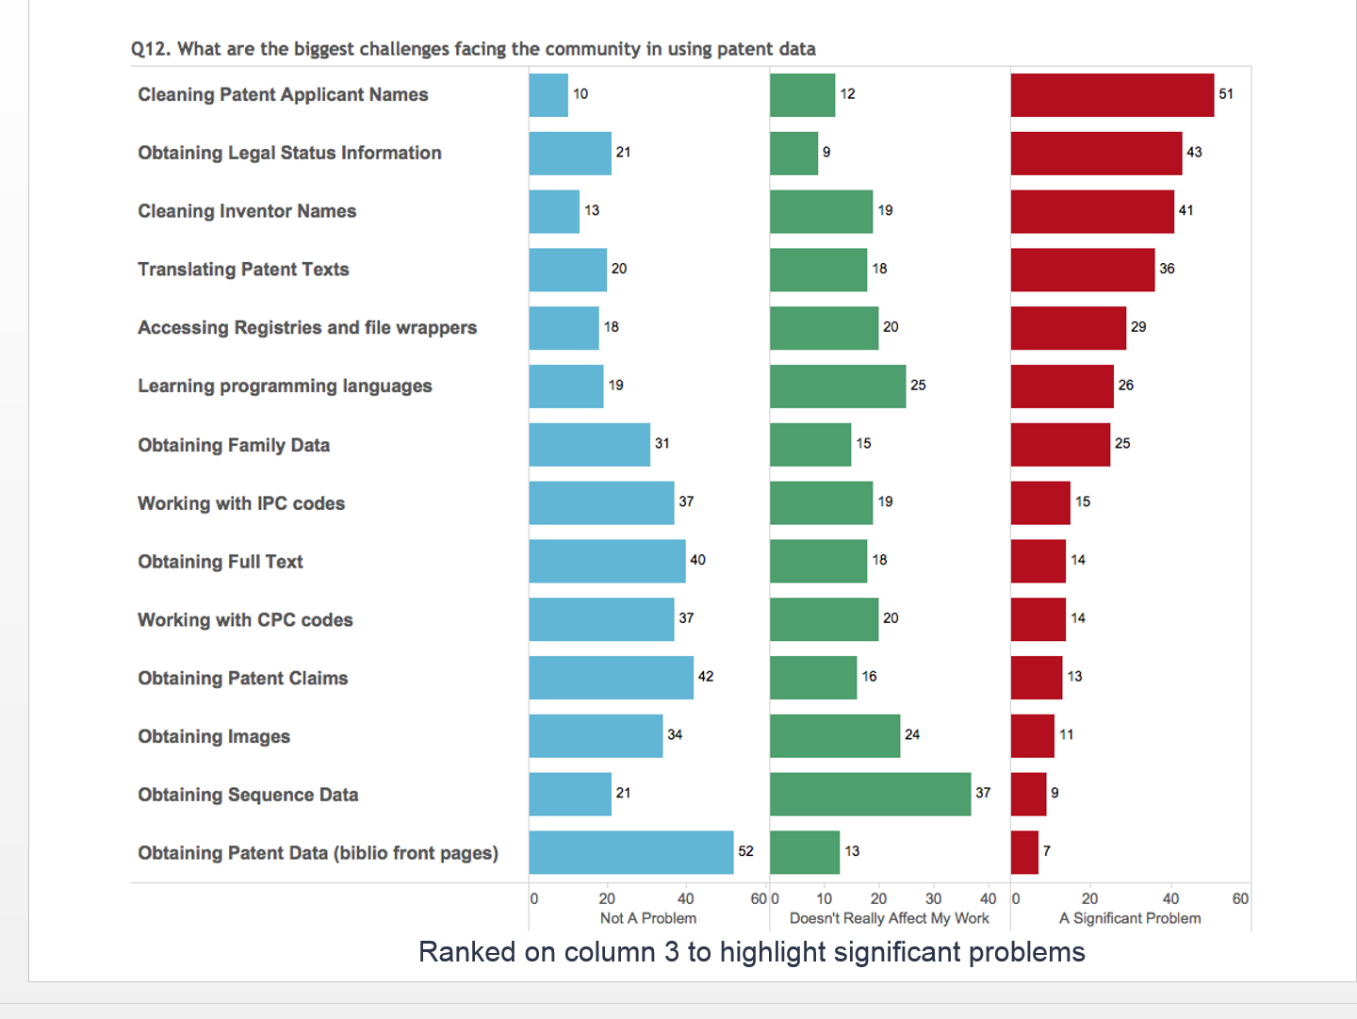
Greatest challenges in patent analytics identified by the survey participants

Slide 46














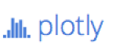
The open source tools era

Slide 47
Typical use of open source tools
Typical user profile:
Researchers
Data scientists
IT
Business analysts
Data typically analyzed through open source tools:
Non-structured data, structured non-patent data
Patent data: not a typical field where open source tools are being used

Slide 48

Pros and cons of open source tools
Advantages
Disadvantages
Free of charge
A lot of them customizable to specific needs
Give flexibility to experiment and choose the tool or combination of tools that is more adapted to the user´s needs
Support and troubleshooting by programmers and other users in various fora
Not as intuitive or user-friendly as commercial tools
Require some programming skills, time and practice
Several bugs/problems
No commercial support

Slide 49
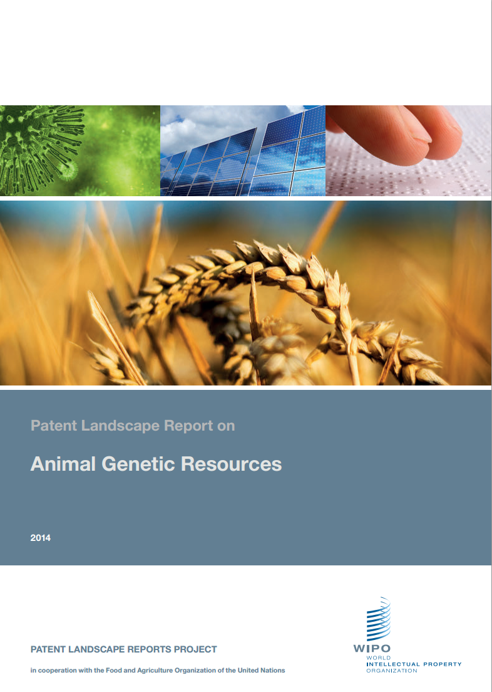
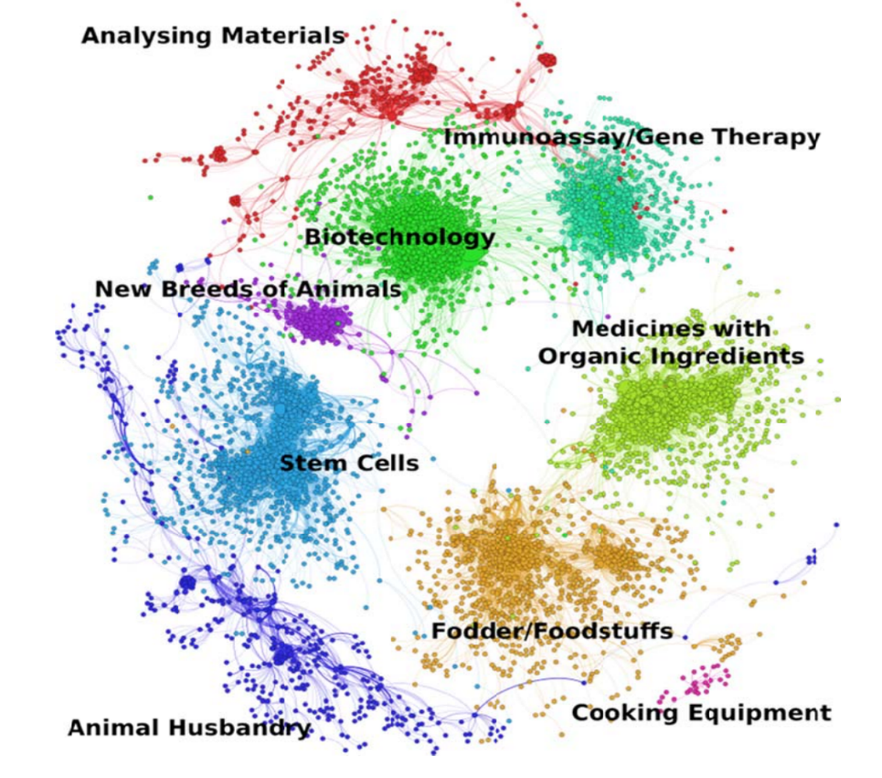
First thoughts on using open source tools for patent analytics
WIPO PLRs 2010-2014: exploring various commercial analysis and visualization tools
2014: WIPO animal genetic resources PLR used for the first time Gephi, an open-source tool.

Slide 50
The Manual on Open Source Tools for Patent Analytics
Project launched in May 2015
Authored by Paul Oldham
Aimed at exploring:
various free and open source tools which could be used for various patent analysis tasks by users in developing countries
How to obtain data to use for patent analytics
How to clean/tidy, analyze, visualize and share patent data with the help of selected open source tools
Challenge: programming skills required
The Manual includes step-by-step instructions on the use of selected open source/free tools

Slide 51
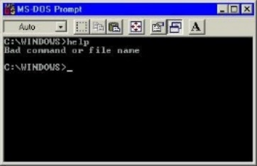
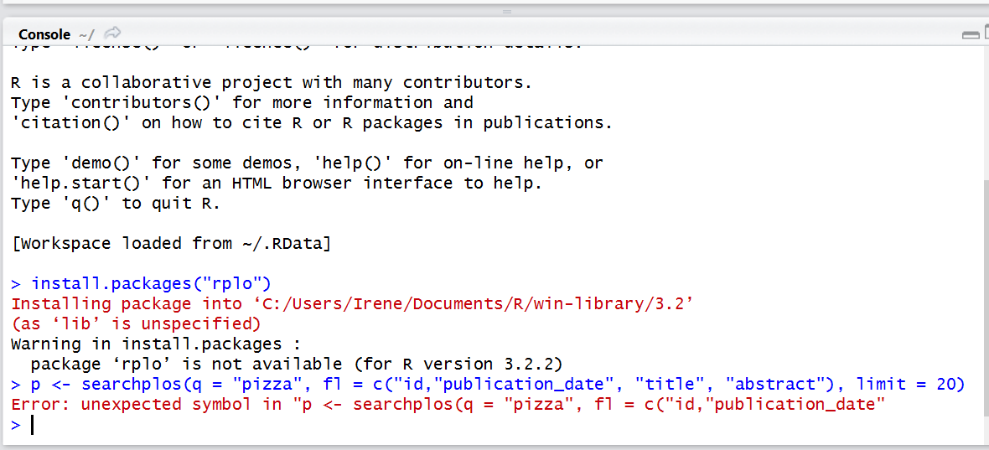
The process and the challenges
1987
2015
Acquiring programming skills – sometimes steep learning curve
Selecting the open source tools to explore and cover in the Manual
Deal with constantly changing open source landscape

Slide 52

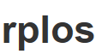












Which analytics tasks, databases and tools does the Manual cover?
Obtaining Data
Cleaning Data
Visualizing Data
Sharing Data
https://wipo-analytics.github.io

Slide 53

What is the profile of a patent analyst?
Patent search skills
Search and analysis tools
Synthesis skills
Attention to detail
Understanding of technical subject matter
Communication skills
Knowledge of IP system/IP Rights
Understanding of business needs/needs assessment
Translation of complex data into meaningful visualizations
Awareness raising about what analytics can provide
Source http://www.toadworld.com/

Slide 54
Thank you!
Irene.Kitsara@wipo.int

